Slide 1
Human Machine Communication
the process of at least two entities “sharing” something, suggesting an act of “bringing together”
humans on the one hand, and machines or “digital interlocutors”
humans and machines engage in “meaning-making” (Guzman 2018, p. 17), establish “relationships - display social behavior
unidirectional (from humans to machines) or bidirectional.
truly comprehend the meaning of the messages, or are completely equivalent to human
humans socially engage with machine

Slide 2
Types
a micro-level layer containing the social situation and immediate reality of the communicators
a meso-level layer where institutions and organizations are located
a macro-level layer encompassing societal structures and system
HMC as a process of message exchange between humans and machines, and its associated meaning-making, relationships, and social behavior, embedded in different layers of social context on micro level, meso level, and macro leve

Slide 3
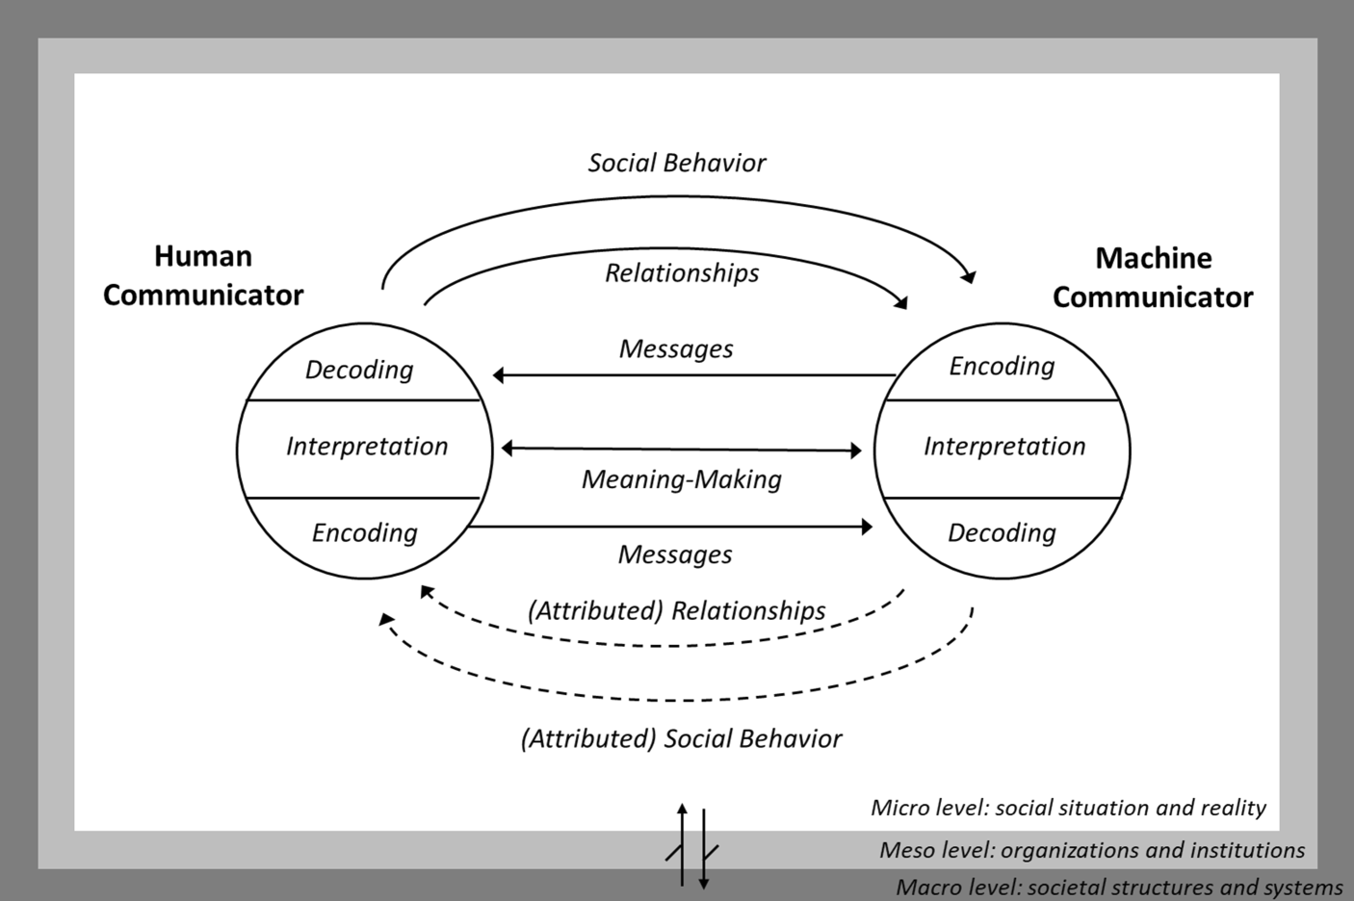

Slide 4
Relevance of human-machine communication
As a result, we are witnessing a profound change, in which communication through technologies is extended by communication with technologies
it implies several theoretical, empirical, and methodological challenges, such as applying, changing, or reconceptualizing approaches.

Slide 5
communication with chatbots, voice assistants, and social robots is already part of our social reality
three drivers: the decrease of human control over the communication process, the increase of the simulation of human mediation of meaning, and the discursive attribution of communication to machines.

Slide 6
Advantages
1- Improved Productivity. 2- Satisfaction/ Pursuit of Happiness
3- Enhance Data Saving/Recording
. 4- Internet of Things
. 5- Data Translation 6- Reduce the Cost of Hardware
An HMI can reduce the cost that an industry incurs in terms of hardware like consoles, panels, cables. An HMI can replace hundreds of them thus saving on costs.

Slide 7
Disadvantages of HMC
1- Security
high risk of hacking. 2- Poor Interface Design
Most accidents involving machine and automobiles are attributed to human error ----poor designing of an HMI

